Slide 1

Final Presentation
Smithers
Jacob Jones, ECE 551

Slide 2
Outline
Introduction – What’s this all about?
Motivation – Why am I doing this?
Background – Contemporary methods
Method – How I did this
Results – Project results
Proposed Research – Further improvements
Conclusions – Wrap up this presentation

Slide 3
Introduction
Smithers is a machine learning model used to detect a wake word
This model uses mel-frequency cepstral coefficients and a convolutional neural net to make predictions on real-time audio
This presentation reports on the progress made towards this effort

Slide 4
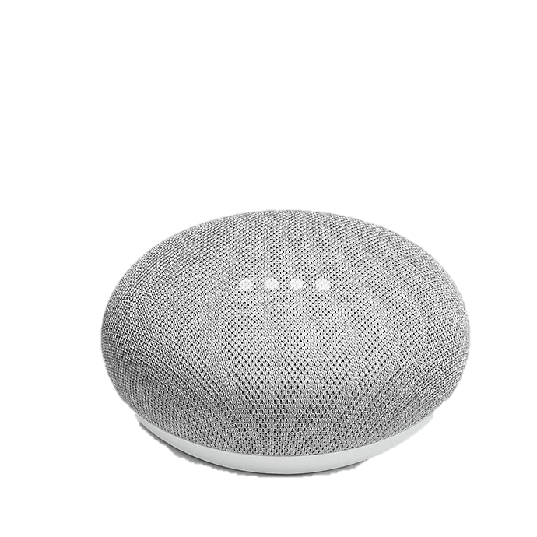
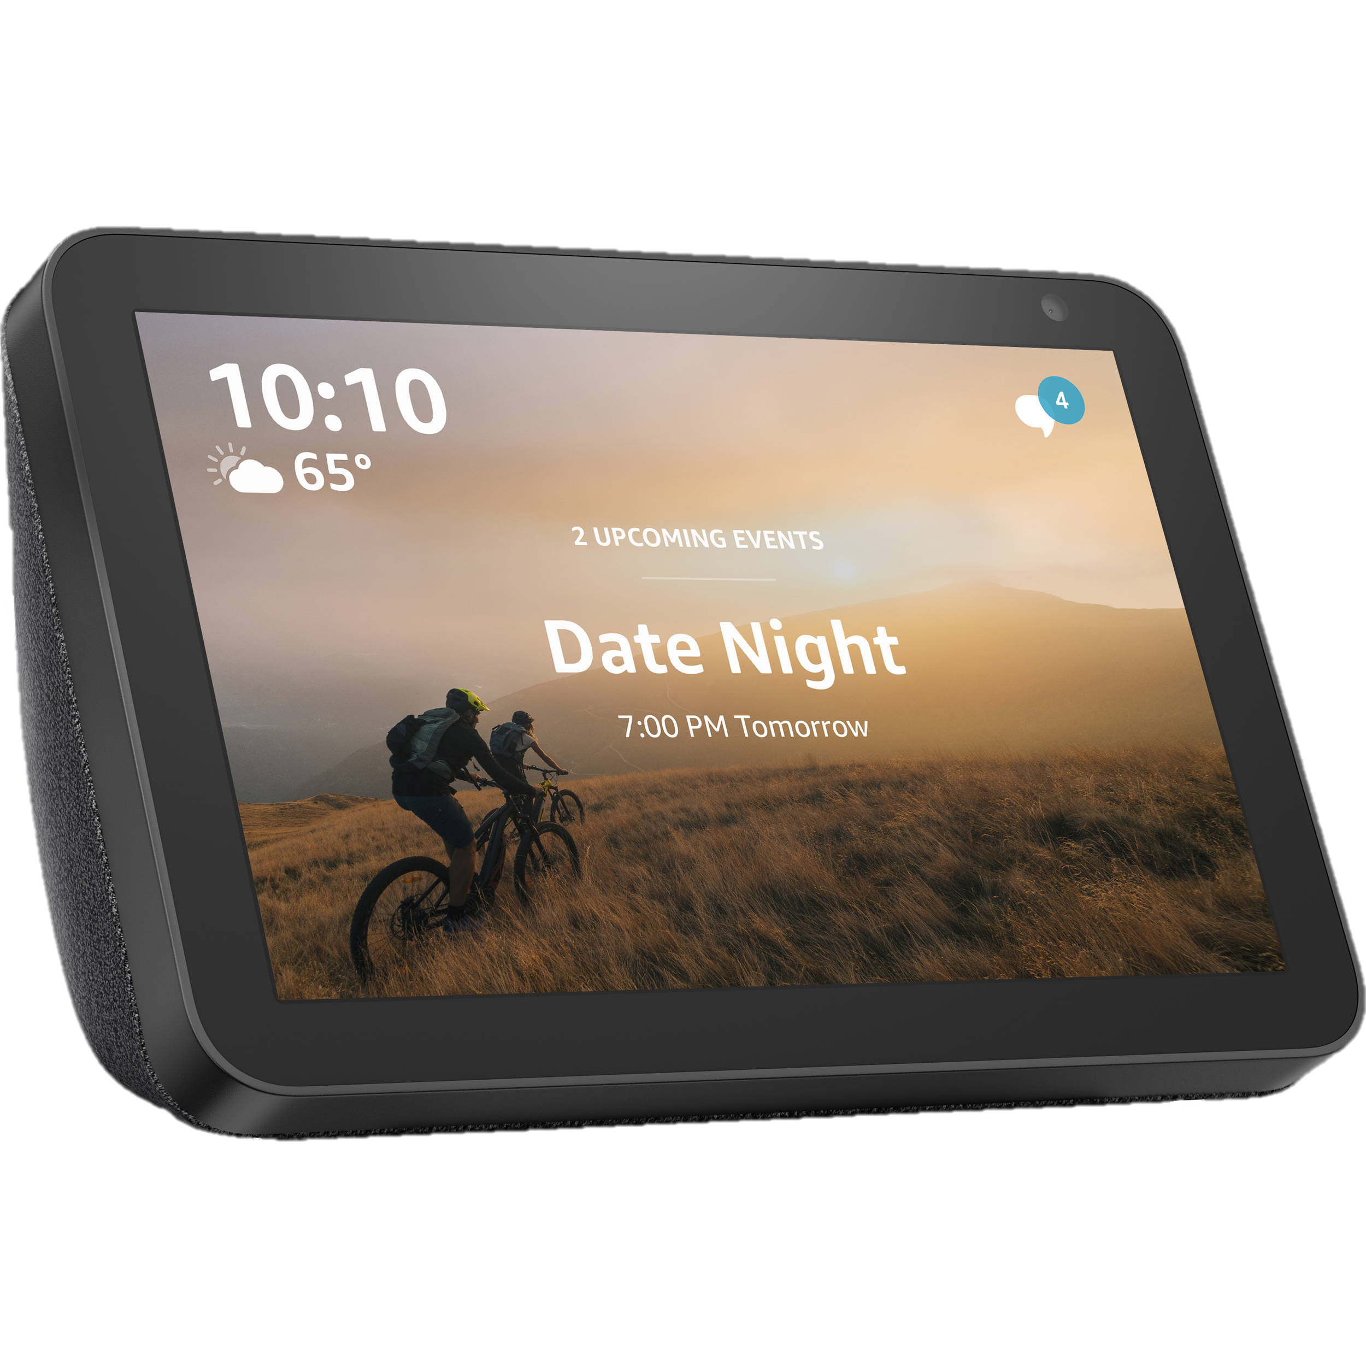
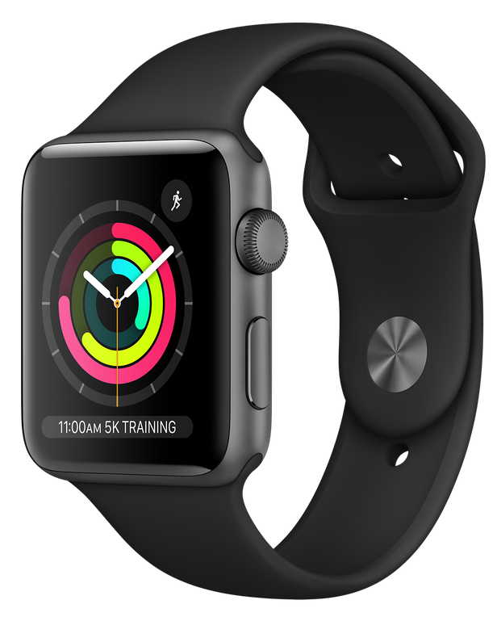
Motivation
Smart devices are everywhere
Smart devices respond to voice commands
Three big ones:
Google Assistant, Alexa, Siri
I am interested in embedded devices
How does voice recognition work on resource-constrained hardware?
Are these devices always listening?
Short answer: No
Long answer: Sort of…

Slide 5
Background
Are these devices always listening?
How do you respond to commands without always listening?
Voice command recognition too computationally intensive
Amazon, Apple, and Google have researched this topic extensively
Common solution: “wake words”
Idea: train model to recognize only one command
“Hey Alexa”, “Hey Siri”, “Hey Google”
Once command is recognized, activate larger model
Some devices place model on separate dedicated processor

Slide 6
Background (cont.)
Common approaches:
Convolutional Neural Nets (CNNs)
Mel-frequency cepstral coefficients (MFCC) – more on these later
Papers referenced:
C. Jose, Y. Mishchenko, T. Senechal, A. Shah, A. Escott, and S. Vitaladevuni, “Accurate detection of wake word start and end using a cnn,” 2020 (Amazon)
G. Chen, C. Parada, and G. Heigold, “Small-footprint keyword spotting using deep neural networks,” in 2014 IEEE International Conference on Acoustics, Speech and Signal Processing (ICASSP), 2014, pp. 4087–4091 (Google)
S. Sigtia, R. Haynes, H. Richards, E. Marchi, and J. Bridle, “Efficient voice trigger detection for low resource hardware,” in INTERSPEECH, 2018 (Apple)
T. -H. Tsai, P. -C. Hao and C. -L. Wang, "Self-Defined Text-Dependent Wake-Up-Words Speaker Recognition System," in IEEE Access, doi: 10.1109/ACCESS.2021.3117602.

Slide 7
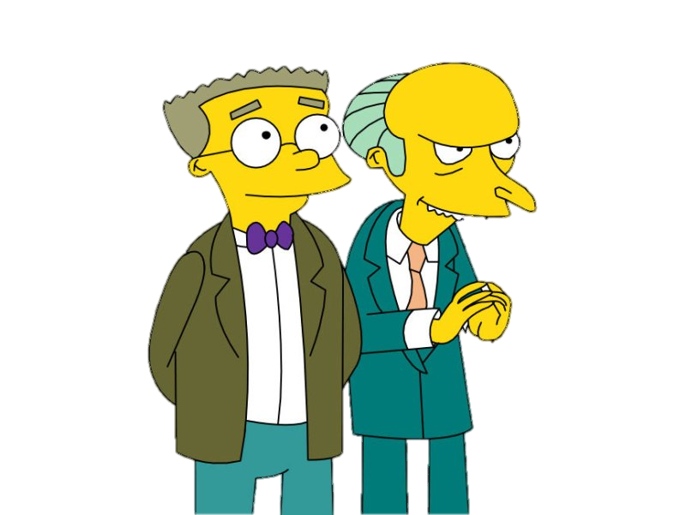
Method – “Smithers”
Develop my own CNN capable of recognizing the wake word phrase “Hey Smithers”
Why “Hey Smithers”? Smithers is the faithful assistant to the crotchety Mr. Burns in The Simpsons
Use methods proposed by the referenced research paper

Slide 8
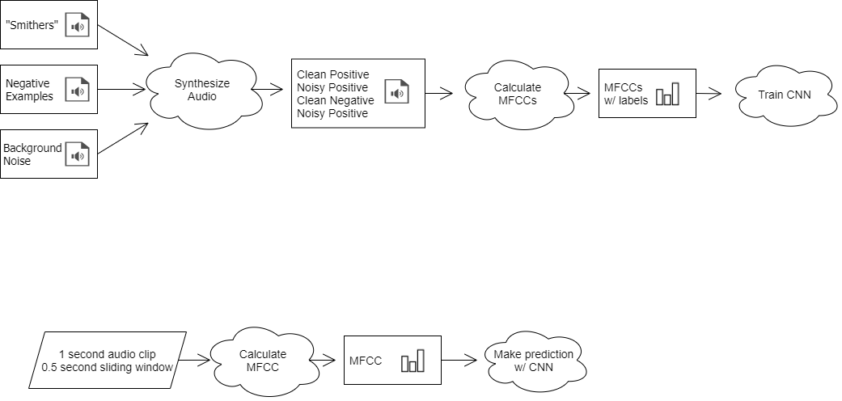
Method (cont.)
Model Training
Implementation

Slide 9
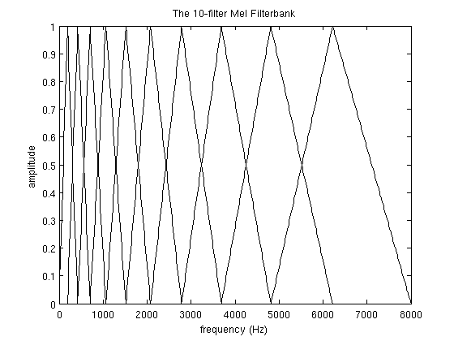
Method (cont.) - MFCCs
Human ear frequency response is not linear
Mel scale better mimics human hearing
MFCCs – take FFT, apply mel filter bank, take logs of powers at each mel frequency, take discrete cosine transform
MFCCs are amplitudes of spectrum
Idea: distil spectrum into only relevant information
Train CNN with mel-frequency cepstral coefficients (MFCCs)
Source: http://practicalcryptography.com/miscellaneous/machine-learning/guide-mel-frequency-cepstral-coefficients-mfccs/

Slide 10
Method (cont.) - CNN
Training:
Training audio will be trimmed into 1 second clips – important!
MFCC coefficients will be calculated for each clip
Convolutional neural net will train on the MFCC coefficients
Implementation:
Two 1-second input audio buffers will be used, spaced 0.5 seconds apart
This sliding window will help when trigger word is split between two 1-second intervals

Slide 11
Results – Data Synthesis
Recorded 36 examples of the wake word phrase “Hey Smithers”
Used 130 negative examples from Google’s Speech Commands Dataset
Used 200 noise clips from Harvard’s ESC-50 dataset
Synthesized 10000 examples each of positive and negative examples
For each loop, choose one positive example, one negative example, and one background noise
Randomly select 1 second interval of noise
Insert each positive example, negative example into random start point of background noise
Save noisy positive, clean positive, noisy negative, and clean negative
Half of dataset is clean, half is noisy
Split data into 80% train, 10% validation, and 10% test sets
16,000 train, 2,000 validation, and 2,000 test samples

Slide 12
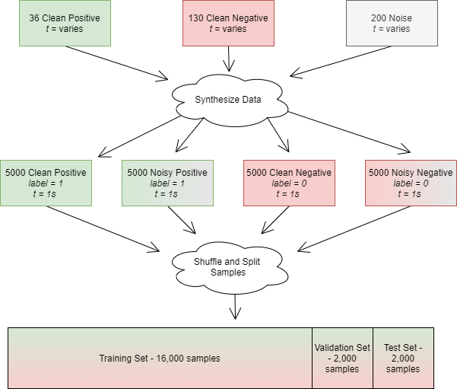
Results (cont.) – Data Synthesis

Slide 13
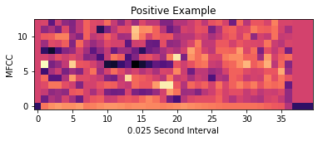
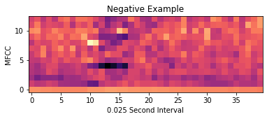
Results (cont.) - MFCCs
Audio was downsampled to 10khz
MFCCs were calculated at 0.025 second intervals – 40 total for each 1 second clip
MFCCs casted from float64 to int8 to reduce computational complexity

Slide 14
Results (cont.) - CNN
Model: "Smithers"
_________________________________________________________________
Layer (type) Output Shape Param #
=================================================================
input_20 (InputLayer) [(None, 13, 40, 1)] 0
_________________________________________________________________
conv2d_57 (Conv2D) (None, 12, 39, 32) 160
_________________________________________________________________
max_pooling2d_57 (MaxPooling (None, 6, 20, 32) 0
_________________________________________________________________
conv2d_58 (Conv2D) (None, 5, 19, 32) 4128
_________________________________________________________________
max_pooling2d_58 (MaxPooling (None, 3, 10, 32) 0
_________________________________________________________________
conv2d_59 (Conv2D) (None, 2, 9, 32) 4128
_________________________________________________________________
max_pooling2d_59 (MaxPooling (None, 1, 5, 32) 0
_________________________________________________________________
flatten_19 (Flatten) (None, 160) 0
_________________________________________________________________
dense_38 (Dense) (None, 16) 2576
_________________________________________________________________
dropout_19 (Dropout) (None, 16) 0
_________________________________________________________________
dense_39 (Dense) (None, 1) 17
=================================================================
Total params: 11,009
Trainable params: 11,009
Non-trainable params: 0
_________________________________________________________________
Image processing CNN architecture
Reduced number of trainable parameters
RelU activation as suggested by Apple
Sigmoid output for [0,1] prediction range
100 sample batch size, 30 epochs for training
Binary cross entropy loss function, SGD optimizer for validation

Slide 15
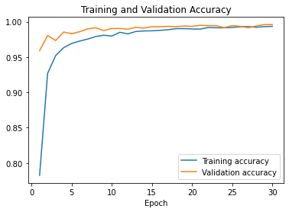
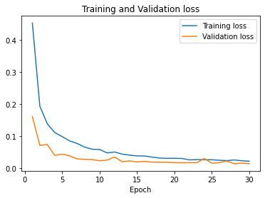
Results (cont.) - Validation
Model works!
Model evaluation on test set: loss: 0.0147 - acc: 0.9960

Slide 16
Results (cont.) - Deployment
Saved model as TensorFlow Lite model
TensorFlow Lite – stripped down framework for “on-device inference”
Model can be deployed on resource-constrained hardware
Requirement – Python
Includes embedded Linux devices like RaspberryPi, custom hardware, etc.
Tested TensorFlow Lite model on development computer
Will load on RaspberryPi if I can get the hardware

Slide 17
Results (cont.) - Discussion
Optimizations for resource-constrained hardware:
Reduced number of CNN parameters
MFCC’s quantized to 8-bit signed ints
Reduced sample rate from 20kHz to 10kHz
Other improvements:
Increased number of samples from 400 to 20,000
Changed wake word phrase from “Smithers” to “Hey Smithers”
3-syllable wake words suggested by Tsai et. al.

Slide 18
Proposed Research
Further optimizations
Reduce sample rate
Reduce number of MFC coefficients?
Reduce number of CNN parameters
Hardware deployment
Device responds to wake word – now what?

Slide 19

Conclusions
Smithers is a machine learning model used to detect a wake word
MFCCs and CNNs are the key components to this model
Model works well!

